Slide 1
Scaffolding Comprehension of Informational Text

Slide 2
Anita L. Archer, Ph.D Author and Educational Consultant archerteach@aol.com

Slide 3
Reading Comprehension:
Before Reading
During Reading
After Reading

Slide 4
Preview - Before Reading Strategies
• Teach the pronunciation and meaning of critical, unknown vocabulary words
• Review, teach or activate any necessary background knowledge
• Preview the text

Slide 5
Before Reading - Vocabulary
“direct vocabulary instruction has an impressive track record of improving students’ background knowledge and comprehension of academic content” Marzano, 2001, p. 69
.97 effect size for direct teaching of vocabulary related to content Stahl & Fairbanks, 1986

Slide 6
Before Reading - Vocabulary
Limit number of words given in depth instruction to 4 to 5 words (Robb, 2003)
Select words that are unknown
Select words that are critical to passage understanding
Select words that students are likely to use in the future (Stahl, 1986)
General academic vocabulary found used in many domains
Domain-specific vocabulary that provides background knowledge

Slide 7
Selection Vocabulary
General academic vocabulary – Words used in many domains. (suitcase words) Examples: contrast, analyze, observe, evidence, theory
Application of general academic vocabulary differs across domains (Hyland & Tse, 2007; Fisher & Blachowicz, 2013)
Math – Analyze givens, constraints, and relationships in problem
Science – Analyze and interpret data
English – Analyze how author develops character

Slide 8
Selection of Vocabulary
Domain-specific vocabulary that provides background knowledge
Examples: tariff, acute angle, foreshadowing
When possible, teach clusters of words that are meaningfully related.
Math: angles, acute, right, obtuse, straight, reflex
Science: cell, nucleus, mitochondrion, vacuole, cell membrane, cell wall, chromosome
Social Studies: colony, ethnic group, migration, society, settlement, settler
Notes:
Cells Vocabulary List & Definitions
cytoplasmJelly-like substance that makes up the matrix of the cell body.mitochondrionShaped like a bean, this cell organelle helps take food and manufacture energy from it.nucleolusA structure inside the nucleus where RNA is transcribed.nucleusthe main brain of the cell that contains most of the cell's DNA.organa body structure that works to perform a specialized function. Examples include the lung or heart.tissuea large series of cells that work together to form a specific function.vacuolestorage areas of the cell known for storing mostly water and/or food.cell membraneThe enclosure of the cell that provides the body for all the organelles.cell wallMostly made of cellulose, this is the tough and rigid outer layer of plant cells.chlorophyllthe green (in color) pigment found in chloroplasts where photosynthesis takes place.chloroplastan egg shaped body that appears green from all the chlorophyll they contain. This organelle is where photosynthesis takes place.chromosomeThin, intertwined pieces of DNA found in the cell's nucleus.Powered by: The Online Teacher Resource (www.teach-nology.com)
© Teachnology, Inc. All rights reserved.

Slide 9
Selection of Vocabulary
Select difficult words that need interpretation.
Words not defined within the text
Words with abstract referent
Words with an unknown concept

Slide 10
Selection of Vocabulary - Summary
Select a limited number of words.
Select words that are unknown.
Select words critical to passage understanding.
Select words that can be used in the future.
Select difficult words that need interpretation.

Slide 11
Selection - Vocabulary
Text: American Journey Chapter 11, Section 1 Publisher: Glencoe Jacksonian Democracy
favorite son | majority | plurality | mudslinging
landslide | nominating convention | tariff | suffrage
nullify | secede

Slide 12
Selection - Vocabulary
Text: My World Chapter 4, Section 3 Publisher: Pearson Central America and the Caribbean Today
* carnival | * Santeria | * diaspora | *microcredit
* ecotourism | indigenous | democracy | parliamentary system
dictatorship | free-trade agreements

Slide 13
Organize words for Instruction
Order words in list to stress relationships between words.
Group words into semantic clusters to create a scheme. (Marzano & Marzano, 1988; Wixson, 1986)

Slide 14
Before Reading - Vocabulary
Step 1. Introduce the word.
Write the word on the board or overhead.
Read the word and have the students repeat the word.
Have students tap out the syllables in the word.
Have students read the word by parts as you loop under the word.
Have students repeat the pronunciation of the word.
(If the word is difficult to pronounce or unfamiliar have the students repeat the word a number of times.)
Introduce the word with me.
This word is suffrage. What word? suffrage
Tap and say the parts of the word. suf frage
Read the word by parts. suf frage
What word? suffrage
Suffrage is a noun.

Slide 15
Before Reading - Vocabulary
Step 2. Introduce meaning of word.
Option # 1. Present a student-friendly explanation.
Tell students the explanation. OR
Have them read the explanation with you.
Present the definition with me.
When someone has suffrage, they have
the right to vote in an election.

Slide 16
Before Reading - Vocabulary
Step 2. Introduce meaning of word.
Option # 2. Have students locate the definition in the glossary or text and break the definition into the critical attributes.
Glossary: Suffrage - the right to vote
suffrage
- the right
- to vote

Slide 17
Before Reading - Vocabulary
Step 2. Introduce meaning of word.
Option # 3. Introduce the word using the meaningful parts in the word.
autobiography auto = self bio = life graph = letters, words, or pictures
hydroelectricity
hydro = water
NOTE: 88% of key science words have Spanish cognates;
1/2 are high frequency words in Spanish

Slide 18
Common Latin and Greek Roots
aqua | water | Greek | aquarium, aqueduct, aquaculture, aquamarine, aquaplane, aquatic
aud | hearing | Latin | audio, audition, audiovisual, auditorium, audiotape, inaudible
auto | self | Greek | autograph, autobiography, automobile, autocrat, autonomy
astro | star | Greek | astronomy, astrophysics, astrology, astronaut, astronomer, asterisk
biblio | book | Greek | Bible, bibliography, bibliophobia, bibliophile, biblioklept
bio | life | Greek | biography, biology,autobiography, bionic, biotic, antibiotic, biome, bioshere, biometrics
chrono | time | Greek | synchronize, chronology,chronic, chronicle, anachronism
corp | body | Latin | corpse, corporation, corps,incorporate, corporeal, corpulence
demo | the people | Greek | democracy, demography,epidemic, demotic, endemic, pandemic
dic, dict | speak, tell | Latin | dictate, dictation, diction, dictator, verdict, predict, contradict, benediction, jurisdiction, predict, indict, edict
dorm | sleep | Latin | dormant, dormitory, dormer, dormouse, dormition, dormitive
geo | earth | Greek | geology, geologist, geometry, geography, geographer, geopolitical, geothermal, geocentric

Slide 19
Common Latin and Greek Roots
graph | to write, to draw | Greek | autograph, biography, photograph, telegraph, lithograph
hydro | water | Greek | hydroplane, dehydrate, hydroelectric, hydrogen, hydrophone
ject | throw | Latin | reject, deject, project, inject, injection, projection
logos, logy | study | Greek | geology, astrology, biology, numerology, zoology, technology, psychology, anthropology, mythology
luna | moon | Latin | lunar, lunacy, lunatic, interlunar
meter | measure | Greek | meter, thermometer, diameter, geometry, optometry, barometer, centimeter, symmetry, voltammeter
mega | great, large, big | Greek | megaphone,megalith, megalomania, megatons, megalopolis
min | small, little | Latin | minimal, minimize, minimum, mini, miniature, minuscule, minute, minority
mit, mis | send | Latin | mission, transmit, transmission, remit, missile,submission, permit, emit, emissary
path | feeling, suffering | Greek | pathetic, pathology, apathy, antipathy, sympathy, telepathy, empathy, sociopath
ped | foot | Latin | pedestrian, pedal, peddle, peddler, pedicure, pedometer
philia | love, friendship | Greek | philosopher, Philadelphia, philanthropist, philharmonic, Philip

Slide 20
Common Latin and Greek Roots
phono | sound | Greek | phonograph, microphone, symphony, telephone, phonogram, megaphone, phony, euphony, xylophone, phony,
photo | light | Greek | photograph, photosynthesis, telephoto, photometer, photophilia
port | carry | Latin | port, transport, transportation, portable, portage, report
spect | see | Latin | respect, inspection, inspector, spectator, spectacles,prospect
scope | look at | Greek | microscope, telescope, periscope, kaleidoscope, episcopal
sol | sun | Latin | solar, solar system, solstice, solarium, parasol
struct | build, form | Latin | instruct, instruction, construction, reconstruction, destruct, destruction, infrastructure, construe, instrument, instrumental
tele | distant | Greek | telephone, television,telegraph, telephoto, telescope, telepathy, telethon, telegenic
terra | land | Latin | territory, terrestrial, terrace, terrarium, extraterrestrial, Mediterranean Sea, terra cotta, subterranean

Slide 21
Before Reading - Vocabulary
Step 3. Illustrate the word with examples.
a. Concrete examples
- objects
- acting out
b. Visual examples
c. Verbal examples

Slide 22
Before Reading - Vocabulary
Suffrage Examples
When the United States was founded only white men with property had suffrage.
At the time of the American Civil War, most white men had been granted suffrage.

Slide 23
Before Reading - Vocabulary
Suffrage Examples
In 1920, women were granted suffrage. The passage of the Nineteenth Amendment granted women the right to vote in all United States elections.

Slide 24
Before Reading - Vocabulary
Suffrage Examples
The Voting Rights Act of 1965 outlawed discriminatory voting practices that denied suffrage to many African Americans in the United States.

Slide 25
Before Reading - Vocabulary
Step 4. Check students’ understanding.
Option #1. Ask deep processing questions. Check students’ understanding with me.
Why is suffrage a critical aspect of a democracy?
Begin by saying or writing:
Suffrage is a critical aspect of democracy for the following reasons. First, ____________

Slide 26
Before Reading - Vocabulary
Step 4. Check students’ understanding.
Option #2. Have students discern
between examples and non-examples.
Check students’ understanding with me.
Tell me suffrage or not suffrage.
The right to run for elected office. not suffrage Why not?
The right to vote. suffrage Why?
The right to develop ads for a candidate. not suffrage Why not?

Slide 27
Before Reading - Vocabulary
Step 4. Check students’ understanding.
Option #3. Have students generate their own examples.
Check students’ understanding with me.
Make a list of ways that suffrage could be limited or compromised.

Slide 28
Before Reading - Vocabulary
suffrage noun
suffragist noun
In 1917, all women in the United States did not have suffrage, the right to vote. Suffragists in New York City collected more than a million signatures of women demanding voting rights. They then paraded down Firth Avenue with the signature placards.

Slide 29
Vocabulary Routine
Introduce the word.
Introduce meaning of word.
Illustrate the word with examples (and non-examples).
Check understanding.

Slide 30
Background Knowledge - What
….what one already knows about a subject. Stevens, 1980
…all the knowledge learners have when entering a learning environment that is potentially relevant for acquiring new knowledge.
Biemans & Simons, 1996

Slide 31
Background Knowledge - Why
Background knowledge of text has a major impact on whether or not a reader can comprehend text.
Anderson & Pearson, 1984; Bransford, Stein, & Shelton, 1984; Wilson & Anderson, 1986
Across grades and reading ability, prior knowledge of subject area and key vocabulary results in higher scores on reading comprehension measures.
Langer, 1984; Long, Winograd, & Bridget, 1989; Stevens, 1980

Slide 32
Background Knowledge - Why
Average correlation between person’s background knowledge of a given topic and extent to which a person learns new information is .66. Marzano, 2004
Prior knowledge has a large influence on student performance, explaining 30 to 60% of variance in performance. Docy, Segers, & Buehl, 1999

Slide 33
Background Knowledge - Why?
Read this paragraph and explain it to your partner.
From a neuroanatomy text (found in Background Knowledge by Fisher and Frey)
Improved vascular definition in radiographs of the arterial phase or of the venous phase can be procured by a process of subtraction whereby positive and negative images of the overlying skull are imposed on one another.

Slide 34
Teach Background Knowledge
BIG IDEA
Even a thin slice of background knowledge is useful.

Slide 35
Teach Background Knowledge
Preparation
1. What is critical?
2. What information would ease acquisition of new knowledge?
3. What information would reduce cognitive overload?
4. What information will increase interest and motivation?

Slide 36
Chapter 11 The Jackson Era 1824-1845
Section 1
Jacksonian Democracy

Slide 37
Main Idea
The political system of the United States changed under Andrew Jackson.
As you read, ask yourself:
What changes in the political system of the United States occurred under Andrew Jackson?

Slide 38
Andrew Jackson Background knowledge
President
7th President
1829 - 1837
Early Life
Parents emigrated from Ireland
Father died before his birth
Mother died when he was 14
Two brothers also died

Slide 39
Andrew Jackson Background knowledge
Career - Military
At 13 joined Continental Army
Major General of Tennessee Militia
Led campaign against Creek Indians in Georgia
In 1815 led military victory over British at the Battle of New Orleans

Slide 40
Andrew Jackson Background knowledge
Career - Politician
Lawyer
US Representative
US Senator
Circuit Judge
President

Slide 41
Andrew Jackson Background knowledge
Personal Life
Married Rachel Jackson
Two adopted children
Owned large cotton plantation with 150 slaves
Killed man in pistol duel

Slide 42
Preview - Informational Passage
As the student previews, he/she discovers:
the topics to be covered,
the information that will be emphasized,
how the material is organized.
In addition, background knowledge is activated.

Slide 43
Preview - Informational Passage
Warm-Up
Before you read a chapter or a section of a chapter in your science, social studies, or health
book, Warm-up. Get an idea of the chapter’s content by previewing
these parts.
BEGINNING
Title
Introduction
MIDDLE
Headings
Subheadings
END
Summary
Questions Curriculum Associates, Skills for School Success

Slide 44
Jacksonian Democracy
The Election of 1824
Striking a Bargain
The Adams Presidency
The Election of 1828
Jackson Triumphs
Jackson as President
“Old Hickory”
New Voters
The Spoils System
Electoral Changes

Slide 45
Preview - During Reading Strategies
Utilize passage reading procedures that provide adequate reading practice
Ask appropriate questions during passage reading
Have students generate questions
Teach text structure strategies that can be applied to passage reading

Slide 46
Comprehension-Informational Text Reading
Read (a paragraph or a number of related paragraphs)
Stop
Respond
answer teacher questions
generate questions/answer questions
verbally retell content (“Paragraph shrinking”)
mark text /add notes in the margins
take notes
map/web content

Slide 47
During Passage Reading
Read
Stop
Respond
-Teacher Asks Questions
- Students Answer Questions

Slide 48
During Passage Reading - Ask Questions
Asking questions. A evidence-based, time honored procedure
The teacher asks questions to guide and monitor students’ comprehension
(Ambruster, Lehr, & Osborn, 2001; National Reading Panel, 2000; McKeown, Beck, & Blake, 2009) )

Slide 49
During Reading - Ask Questions
The Teacher-Generated Questions
Divide the material into appropriate segments.
Develop questions on the content, focusing on the most important understanding that students should construct.
OR
Curriculum Questions
Ask questions provided by the curriculum material.

Slide 50
Guidelines for Asking Questions
Ask text-dependent questions - The student must read the text to respond to the question
Creating better questions
Ask higher order questions - Inferences, predictions, comparisons, summaries
Scaffold higher order questions with foundation questions on key details
Scaffold answers with sentence starters
Use appropriate active participation procedures for asking questions

Slide 51
During Reading - Text-Dependent Questions
Ask questions that focus on information (evidence) provided in the text.
Students must answer the questions based on passage information NOT on previous experience or personal ideas.
Keep students cognitively in the text… don’t draw them out of the text.

Slide 52
During Reading - Scaffolding Fisher & Frey, 2012
Scaffold higher order questions by first asking literal, foundation questions.
Opinions, arguments,
intertextual connections
Inferences
Author’s Purpose
Vocabulary
Key Details
General Understanding

Slide 53
During Reading - Scaffold Higher Order Questions
Scaffolding Questions
How many political parties were there in 1824?
Four men in the party ran for president. Did Andrew Jackson get a majority of votes?
Which of the 4 candidates received the most votes?
Who did the House of Representatives select as president?
Who helped Adams to be elected as president?
What position in the government was Clay given?
Big Question to be asked:
Why were Adams and Clay accused of making a “corrupt bargain”
(stealing the election)?
Sentence Starter: Adams and Clay were accused of making a corrupt bargain because..........

Slide 54
During Reading - Ask Questions
Procedure for asking students questions on text material.
Saying answer to partner (Partners First)
1. Ask a question
2. Give students thinking time or writing time
3. Provide a verbal or written sentence starter or paragraph frame
4. Have students share answers with their partners using the sentence starter
5. Call on a student to give answer
6. Engage students in a discussion

Slide 55
During Passage Reading
Read
Stop
Respond
- Students generate questions
- Students answer questions

Slide 56
During Reading - Students generate and answer questions
Student-Generated Questions based on Headings and Subheadings
Read the heading or subheading.
Generate one or two questions .
Read the section.
Answer the question.

Slide 57
Classifying Rocks
Question How do you classify rocks? How are rocks classified? | Answer Rocks are classified by mineral composition, color, and texture.
Notes:
How do you classify rocks? By mineral composition, color, and texture
How are rocks classified?

Slide 58
How Rocks Form
Question | Answer
Igneous rocks How do igneous rocks form?
Sedimentary rocks How do sedimentary rocks form?
Metamorphic rocks How do metamorphic rocks form?
Notes:
How do igneous rocks form? Cooling of magma or lava
How do Sedimentary Rocks form? Rock particles and remains of plants and animals are pressed together.
How are metamorphic rocks formed? Existing rock is changed by heat, pressure, or chemical reaction deep
underground.

Slide 59
How Rocks Form
Question | Answer
Igneous rocks | Igneous rocks are formed when magma or lava cools.
Sedimentary rocks
Metamorphic rocks
Notes:
How do igneous rocks form? Cooling of magma or lava
How do Sedimentary Rocks form? Rock particles and remains of plants and animals are pressed together.
How are metamorphic rocks formed? Existing rock is changed by heat, pressure, or chemical reaction deep
underground.

Slide 60
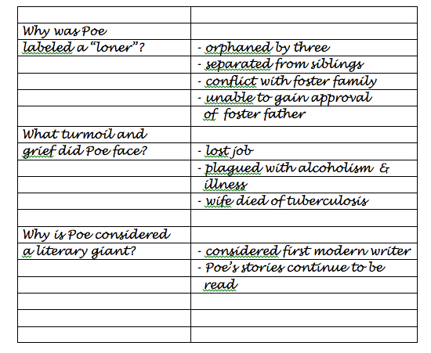

Slide 61
During Passage Reading
Read
Stop
Respond
-Students create main idea statements
-Students respond to teacher or partner questions

Slide 62
During Reading - Students generate main idea statements
Paragraph Shrinking Name the who or what. (The main person, animal, or thing.) Tell the most important thing about the who or what. Say the main idea in 10 words or less. (Optional: Record your main idea sentence.) (From the PALS program by Fuchs, Mathes, and Fuchs)

Slide 63
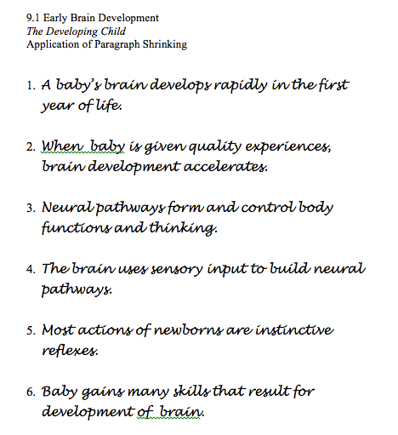

Slide 64
During Passage Reading
Read
Stop
Respond
- Students “mark” the text
- Students write notes in the margins

Slide 65
During Reading - Students “mark” the text
1. Number the paragraphs
2. Circle the topic and/or key terms
3. Underline the author’s claims or other critical information

Slide 66
During Reading - Students write notes in the margins
Notes in the margin might include: - A drawing to illustrate a point - A summary of the content
- Key vocabulary terms and definitions
- Responses to interesting information, ideas, or claims

Slide 67
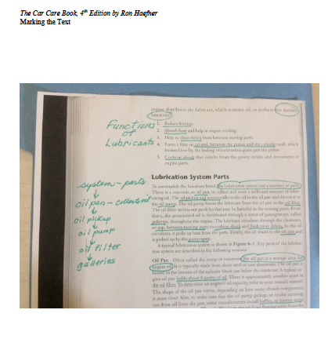

Slide 68
During Passage Reading
Read
Stop
Respond
- Students take notes
- Students map/web the content

Slide 69
During Reading - Students take two column notes
Antarctica | - far south continent
 | - South Pole
 | - Covered with ice
Weather | - Harsh
 | - Below Freezing
 | - Windy
Living Things | - Few
 | Antarctica, the most southern continent, has very harsh weather and is covered in ice. Few living things survive on Antarctica.

Slide 70
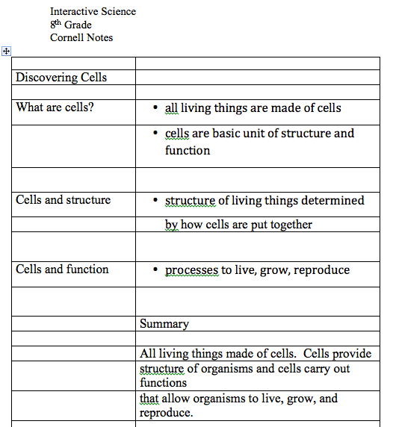

Slide 71
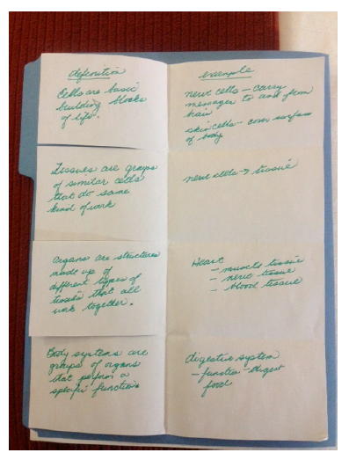
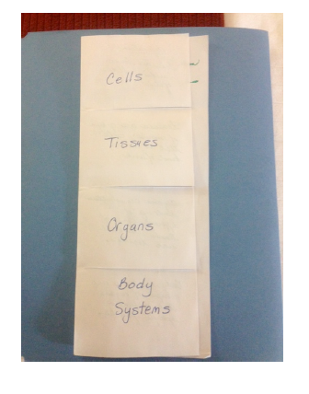

Slide 72
During Reading - Students map or web the content
Land
Weather
far south
South Pole
covered w/ice
-harsh
-below freezing
-windy
Antarctica
Living Things
- few can survive

Slide 73
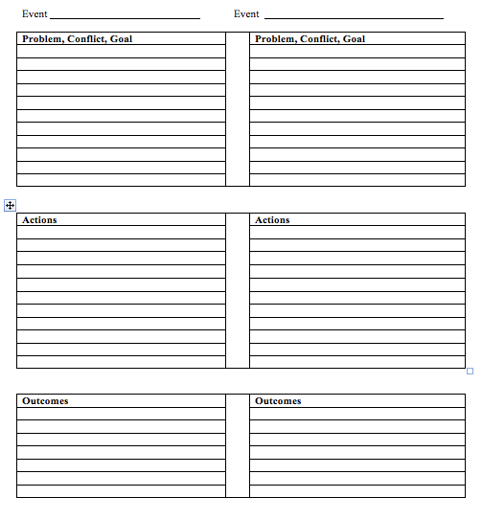

Slide 74
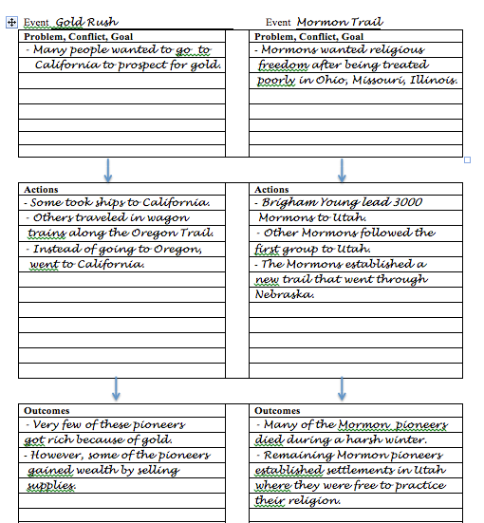

Slide 75
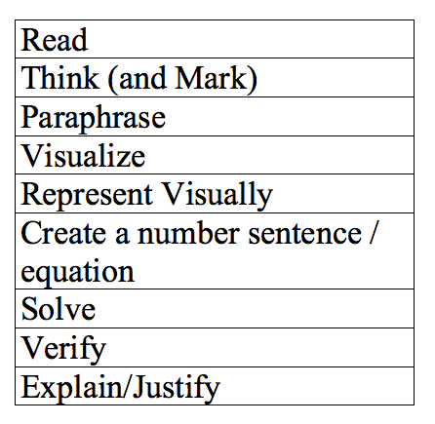

Slide 76
Preview - After Reading Strategies
Have students complete or generate graphic organizers that summarize critical information
Have students write in response to a passage:
Summary
Compare and Contrast
Opinion

Slide 77
After Reading - Graphic Organizers
The teacher:
Provides students with a graphic organizer that reflects the structure of the text material
Central Idea
Hierarchy
Compare/Contrast
Sequence of Events
Cause/Effect
Problem/Solution

Slide 78
After Reading - Graphic Organizers
After completing the graphic organizer, students:
Teach the content on the graphic organizer to their partners
Use the graphic organizer as a support during class discussions
Write a summary of the content based on the graphic organizer

Slide 79
Write a Summary - Writing Frames
Antarctica is the coldest continent on the earth. The land is covered with _________________________. The temperature stays below __________________ and the _____________ constantly blow. Because of these conditions, not many ____________ things are found on this continent.

Slide 80
Write a Summary - Writing Frames
Summary of Informational Text
Chapter: __________ Topic: _______________
In this section of the chapter, a number of critical points were made about …
First, the authors pointed out that…
This was important because…
Next, the authors mentioned that…
Furthermore, they indicated…
This was critical because…
Finally, the authors suggested that…

Slide 81
Write a Summary - Writing Frames
Chapter: Drifting Continents Topic: Wegener's Theory
In this section of the chapter, a number of critical points were made about Alfred Wegener's theory of continental drift. First, the authors pointed out that Wegener believed that all the continents were once joined together in a single land mass that he called Pangaea that drifted apart forming the continents of today. This was important because it explained why the outline of the continents as they are today fit together. Next, the authors mentioned that Wegener argued that there were many pieces of evidence supporting his theory of continental drift. Furthermore, they indicated that Wegener used evidence of similar landforms and fossils on different continents to prove his theory. This was critical because this evidence could be validated by other scientists. Finally, the authors suggested that despite this evidence, other scientists did not accept Wegener's theory because he could not explain the force that pushes and pulls the continents.

Slide 82
Write a Summary - Writing Frames
Summary of Opinion Article
Name of Article:…
Author: …
Topic: …
In this article, _________. discusses…
The author's primary claim is that ....
First, she/he states….
She/he then points out that ...
In addition, ___________, indicates that….
Finally, she/he conclude…..

Slide 83
Write a Summary - Writing Frames
Summary of Opinion Article
Name of Article:…
Author: …
Topic: …
In this article, _________. discusses…
The author's primary claim is that ....
First, she/he states….
She/he then points out that ...
In addition, ___________, indicates that….
Finally, she/he conclude…..

Slide 84
Write a Summary - Writing Frames
Name of Article: The Writing Revolution
Magazine/Journal: the Atlantic (September, 2012)
Author: Peg Tyre
Topic: Writing Instruction
In this article, Peg Tyre discusses writing instruction in today's schools. The author's primary claim is that a return to traditional, explicit instruction on the fundamentals of writing could be the answer to poor writing exhibited in schools. First, she states that teachers at New Dorp High School determined that their students poor performance was due to the fact that they could not express their ideas on paper. She then points out that when New Dorp adopted intense, explicit instruction on the skills of analytic writing, test scores and graduation rates improved. In addition, Tyre indicates that thinking, speaking, and reading skills are strengthened through writing instruction. Finally, she concludes that a return to traditional writing instruction may be the key to improving the writing skills of failing students.

Slide 85
Write a Summary - Strategy
Write down the topic of the summary.
List - Make a list of important ideas.
Cross-out - Cross out any unnecessary or weak ideas.
Connect - Connect ideas that could go in one sentence.
Number - Number the ideas in the order that they will appear in the paragraph.

Slide 86
List - Make a list of important ideas.
Penquin’s birth
Male takes care of egg
Female lays egg
Female leaves
Female spends winter at sea
The water is very cold
Male puts egg on his feet under belly
Male stays on egg for two months
Male doesn’t eat
Egg hatches
Male must care for baby

Slide 87
Cross-out - Cross out any unnecessary or weak ideas. Connect - Connect ideas that could go in one sentence.
Penquin’s birth
Male takes care of egg
Female lays egg
Female leaves
Female spends winter at sea
The water is very cold
Male puts egg on his feet under belly
Male stays on egg for two months
Male doesn’t eat
Egg hatches
Male must care for baby

Slide 88
Number - Number the ideas in the order that they will appear in the paragraph.
Penquin’s birth
3 Male takes care of egg
1 Female lays egg
2 Female leaves
Female spends winter at sea
The water is very cold
Male puts egg on his feet under belly
4 Male stays on egg for two months
5 Male doesn’t eat
Egg hatches
6 Male must care for baby

Slide 89
Write a summary - Strategy
The birth process of penguins is fascinating and quite different from that of other animals. The female penguin lays an egg. However, the female penguin leaves soon after laying the egg and spends the winter in the sea. Meanwhile the male must take care of the egg. For two months, he places the egg on his feet under his belly. During this time, the male penguin doesn’t eat. Even after the baby penguin hatches, the male penguin continues to take care of the infant penguin.

